Slide 1
Regular Expressions
By
Ms. P.Malathi
Assistant Professor(Sr.Gr), CSE Dept,
ASE, CBE

Slide 2
Definition
Let Σ be a given alphabet.
Then:
1. ∅, λ, and a ∈ Σ are all regular expressions. These are called primitive regular expressions.
2. If r1 and r2 are regular expressions, then r1 + r2, r1 · r2, r ∗ 1 , and (r1) are also regular expressions.
3. A string is a regular expression if and only if it can be derived from the primitive regular expressions by a finite number of applications of the rules in (2).

Slide 3
The regular expression operators are as follows:
r + s / r U s represents the union of two regular expressions.
r · s is the concatenation of two regular expressions.
r ∗ is the star closure of a regular expression.
(r) is the same as regular expression r. It is parenthesized to express the order of operations explicitly.

Slide 4
For example, consider regular expression (a + (b · c))∗ over the alphabet {a, b, c}.
Note : use of parentheses.
1. a, b, and c are primitive regular expressions.
2. (b · c) is a concatenation of regular expressions b and c.
3. (a + (b · c)) is union of regular expressions a and (b · c).
4. (a + (b · c))∗ is the star-closure of regular expression
(a + (b · c)).

Slide 5
As with arithmetic expressions, precedence rules and conventions can be used to relax the need for parentheses.
Star-closure ( ∗ ) has a higher precedence (i.e., priority or binding power) than concatenation (·). That is, r · s ∗ is equal to r · (s ∗ ), not (r · s) ∗
Concatenation (·) higher precedence than union (+). That is, r · s + t is equal to (r · s) + t, not r · (s + t). And, transitively, star-closure has a higher precedence than concatenation.
Concatenation operator (·) can usually be omitted.
That is, rs means r · s.

Slide 6
Languages Associated with Regular Expressions
The language L(r) denoted by any regular expression r is defined (inductively) by the following rules.
Base cases:
1. ∅ is a regular expression denoting the empty set.
2. λ is a regular expression denoting {λ}.
3. For every a ∈ Σ, a is a regular expression denoting {a}.
Inductive cases:
If r1 and r2 are regular expressions, then
4. L(r1 + r2) = L(r1) ∪ L(r2)
5. L(r1 · r2) = L(r1)L(r2)
6. L((r1)) = L(r1)
7. L(r ∗ 1 ) = (L(r1))∗

Slide 7
Example : Show the language L(a ∗ · (a + b)) in set notation.
L(a ∗ · (a + b))
= { Rule 5 }
L(a ∗) L(a + b)
= { Rule 7 }
(L(a))∗ L(a + b)
= { Rule 4 }
(L(a))∗ (L(a) ∪ L(b))
= { definition of star-closure of languages }
{λ, a, aa, aaa, . . .} {a, b}
= { definition of concatenation of languages }
{a, aa, aaa, ..., b, ab, aab, aaab, . . .}

Slide 8
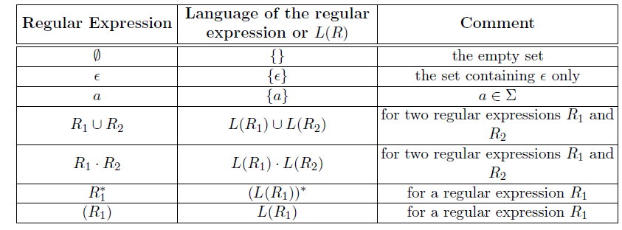
Languages Associated with Regular Expressions
Each expression corresponds to a language.

Slide 9
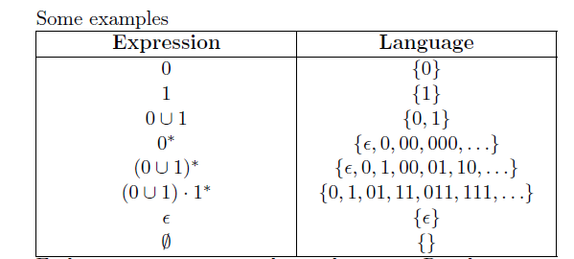
Some examples of REs and their corresponding languages.

Slide 10
Problem 1: Construct a RE for the language which accepts only ‘a’ or ‘b’.
Solution : L(r) = a + b
Problem 2: Construct a RE for the language which ends with 1 over {0,1}.
Solution: L(r) = (0+1)* . 1
Problem 3: Find a RE for the language L={aaa, aab, aba, abb, baa, bab, bba, bbb}.
Solution: (a+b) . (a+b) . (a+b)
Problem 4: Given Language L = {a, c, ab, cb, abb, cbb, abbb, ……}. Find RE?
Solution: r = (a + c ). b*

Slide 11
Problem 5: Find a RE for the language L={w {0,1}* : w has no pair of consecutive zeros }
Solution : r = ( 1 + 01)* . ( 0 + )
Problem 6: Give a RE for the following language on {a,b}
L = { w : |w| mod 3 = 0}
Solution : r = ((a + b ). ( b + a ). (a + b ))*
Problem 7 : Write the L(r) for the given RE
r = (a + b ). ( a + bb )
Solution : L(r) = {aa, abb, ba, bbb}

Slide 13
Thank You

